Slide 1

ABAP DATABASE TABLES
SAP ABAP
AUGUST 2023

Slide 2

Agenda
Data Tables
Introduction,
Types of Tables,
Components or Constraints to create table,
How to create table? Demo.

Slide 3
Introduction
What are Tables in ABAP?
A table is a 2D structure that can be created independently of the database, comprising a grid of rows and columns
Rows of a table are called records and columns are called fields
Rows are individual entries, while columns contain data types & domains
The definition of a database table consists of the following:
A flat, non-nested structure in ABAP Dictionary with its technical and semantic attributes.
Additional technical attributes of the database table.
Additional semantic attributes of the database table.

Slide 4
DATABASE TABLE AND TYPES
1. Transparent Table
ABAP transparent table contains the application data that represents the master data or transaction data used by an application.
A table of vendors or table of customers is an example of the master data. In transparent tables, the database table has the same name and the same number of fields with field names as the data dictionary table.
The transparent table shows the one-to-one relationship with the table definition in the SAP database.
2. Pooled Tables
The pooled table in ABAP shows the many-to-one relationship with the table definition in the database, which means for a single table defined in the SAP database, there are various tables in the ABAP dictionary.
The names of the tables stored in the Dictionary and the database must be different.
The SAP database stores all the Pooled tables in a single table, which is known as a table pool.

Slide 5
3. Cluster Tables:
Cluster tables are like the Pooled tables, as they also show the many-to-one relationship with the table definition in the SAP database. All the cluster tables are stored in a single table in the database, and that table is known as a table cluster.
The tables in the data dictionary must have at least one primary key field in common, and the table is usually accessed simultaneously.

Slide 6
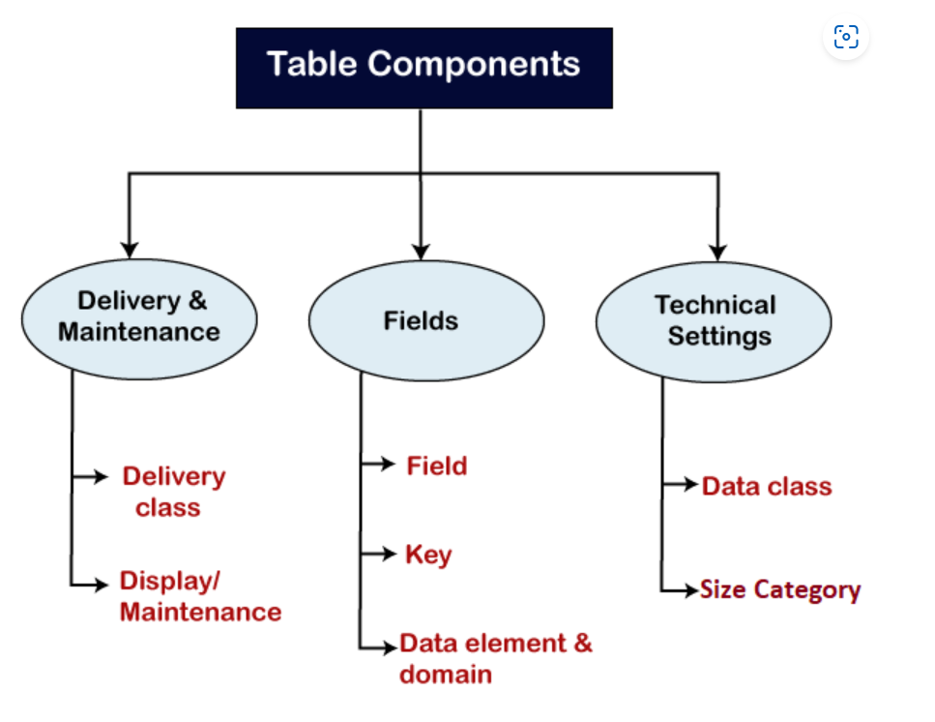
Components of Table in ABAP DDIC

Slide 7
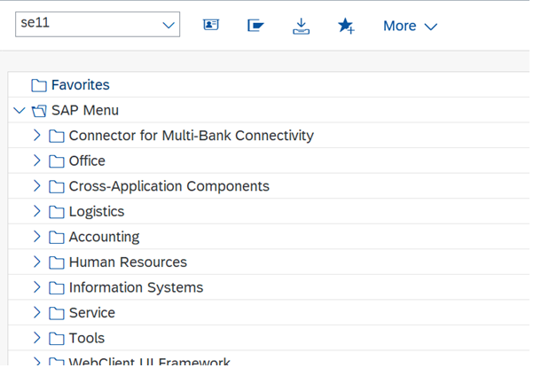
Getting started with ABAP TABLE: How to Create Table
How to a Create Table
Step 1: Enter transaction code SE11 from where we can create a table and press Enter.

Slide 8
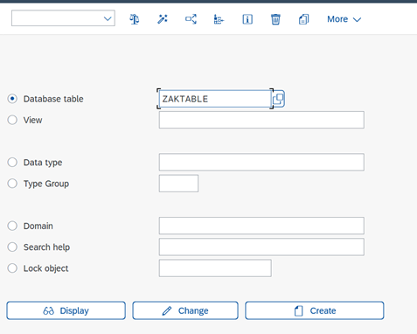
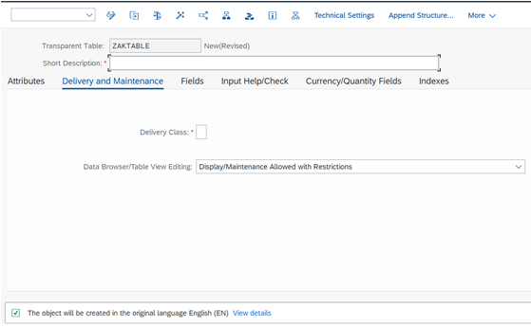
Step 2: You will get below window. Enter the table name which you want to create.
Note: Table name should start with Y or Z only.
Step 3: Click on Create button. You will get below window.
Step 4: Enter Short Description. Enter Delivery Class as A. Select Display/Maintenance Allowed from the dropdown Data Browser/Table View Editing.

Slide 9
What is Delivery Class?
Delivery class is how database table is going to be transported during installation, upgrade, and copies within landscapes, clients and customer systems.
Types of Delivery Class
There is a total of 7 Delivery Classes in SAP ABAP.
A
If we select this delivery class type that we are creating application table which contain master data or transaction data. Application Tables are transported to the customer as empty.
Master data means the data which rarely gets changed. For example, Customer data, Address data.
Transaction Data means the data which change frequently. For example, Sales Data.
C
These are client specific customer table used for customize application. Here data is only entered by the customer.
L
These tables used to store temporary data. Tables are delivered to customer as empty.
G
Customer table where SAP can add data but can not modify or delete it.
E
System table in which customers can make entries. System tables are delivered with some data.
S
These tables are System table delivered by SAP with predefined data as part of system.
W
System table for system administration data. A system table in the delivery class W usually delivered with predefined data by SAP.

Slide 10
Data Browser/Table View Editing.
Data browser/table view editing allows you to edit the contents of the table, create entries into the table, delete entries from the table using table maintenance tools.
Table maintenance tools are data browser (Transaction SE16), table/view maintenance (Transaction SM30/SM31) and Generate Table maintenance Dialog (Transaction SE54).
There are four options in data browser/table view editing
Display/Maintenance allowed with restrictions
If we select this option in dropdown, using data browser (Transaction SE16) display of the table contents is possible but no maintenance is allowed.
Using table/view maintenance (Transaction SM30/SM31) display and maintenance of the table/view is not allowed.
Using Generate Table Maintenance Dialog (Transaction SE54) tool only display of the table contents is allowed no maintenance.
Display/Maintenance Allowed
If we select this option in dropdown, using data browser (Transaction SE16) display of the table contents as well as maintenance of table/view is allowed.
Using table/view maintenance (Transaction SM30/SM31) display and maintenance of the table/view is allowed.
Using Generate Table Maintenance Dialog (Transaction SE54) tool display of the table contents and maintenance is allowed.

Slide 11
Display/Maintenance Not Allowed
If we select this option in dropdown, using data browser (Transaction SE16) display of the table contents as well as maintenance is not allowed.
Using table/view maintenance (Transaction SM30/SM31) display and maintenance of the table/view is not allowed.
Using Generate Table Maintenance Dialog (Transaction SE54) tool display of the table contents as well as maintenance is not allowed.
Only Display Allowed
If we select this option in dropdown, using data browser (Transaction SE16) display of the table contents is possible but no maintenance is allowed.
Using table/view maintenance (Transaction SM30/SM31) display is allowed and maintenance of the table/view is not allowed.
Using Generate Table Maintenance Dialog (Transaction SE54) tool only display of the table contents is allowed no maintenance.

Slide 12
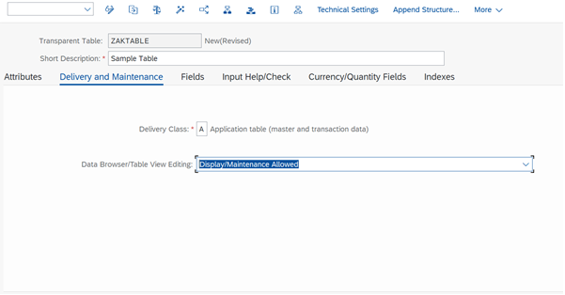
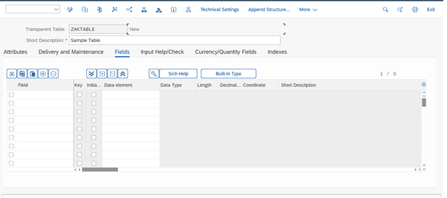
Cont…
Step 5: Press Save button and save it in your existing package. Click on Fields Tab. You will get below window.

Slide 13
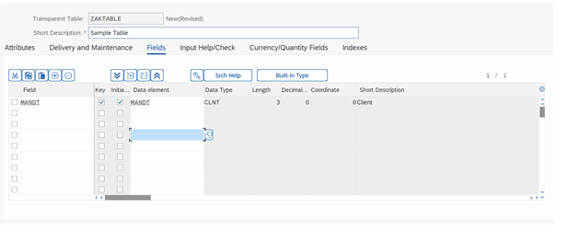
Cont.…
Step 6: Add fields into the table. First add MANDT field and make it key also add the MANDT as a data element. Press Enter.

Slide 14
What is MANDT?
MANDT is a client field. Here client means area. If we have MANDT field in our table that means table is client dependent and if we don’t have that field that means table is client independent.
Client dependent means if we create table in one client it will be accessible only in that client and it is not accessible in other clients.
Client independent means if we create table in one client it will be accessible in that client and other client also.
MANDT is a standard data element which is already created by SAP. Hence, we are reusing it here.

Slide 15
Technical Settings
The technical settings of a table define how the table will be handled when it is created in the database, that is whether the table will be buffered and whether changes to data records of the table will be logged.
The most important parameters are:
Data class : The data class defines the physical area of the database (tablespace) in which the table should be created.
If you choose the data class correctly, your table is automatically assigned to the correct area (tablespace or DB space) of the database when it is created. Each data class corresponds to a physical area in which all the tables assigned to this data class are stored. There are the following data classes:
APPL0 (master data): Data which is seldomly changed. An example of master data is the data contained in an address file, such as the name, address and telephone number.
APPL1 (transaction data): Data that is frequently changed. An example of transaction data is the goods in a warehouse, which change after each purchase order.
APPL2 (organizational data): Customizing data that is defined when the system is installed and seldomly changed. An example is the table with country codes.

Slide 16
Size category : The size category defines the size of the extents created for the table.
The size category defines the expected space required for the table in the database. You can choose a size category from 0 to 4 for your table. Each category is assigned a certain fixed memory size in the database, which depends on the database system used.
When a table is created, initial space (an Initial Extent) is reserved in the database. If more space is required later due to data entries, additional memory will be added depending on the selected size category.
When the table is created in the database, the required information about the memory area to be selected and the extent size is determined from the technical settings.

Slide 17
Buffering permission : The buffering permission defines whether the table may be buffered.
You must define whether and how a table is buffered in the technical settings for the table. There are three possibilities here:
Buffering not permitted: Table buffering is not permitted, for example because application programs always need the most recent data from the table, or the table is changed too frequently.
Buffering permitted but not activated: Buffering is permitted from the business and technical points of view. Applications which access the table execute correctly with and without table buffering. Whether or not table buffering will result in a gain in performance depends on the table size and access profile of the table (frequency of the different types of table access). Table buffering is deactivated because it is not possible to know what these values will be in the customer system. If table buffering would be advantageous for the table size and access profile of the table, you can activate it in the customer system at any time.
Buffering activated: The table should be buffered. In this case you must specify a buffering types.

Slide 18
Buffering Types:
The buffering type defines which table records are loaded into the buffer of the application server when a table record is accessed. There are the following buffering types:
Full buffering : All the records of the table are loaded into the buffer when one record of the table is accessed.
Generic buffering : When a record of the table is accessed, all the records having this record in the generic key fields (part of the table key that is left-justified, identified by specifying several key fields) are loaded into the buffer.
Single-record buffering : Only the records of a table that are really accessed are loaded into the buffer.

